Slide 1
3D Printing
Part 2 - Bag Tag

Slide 2
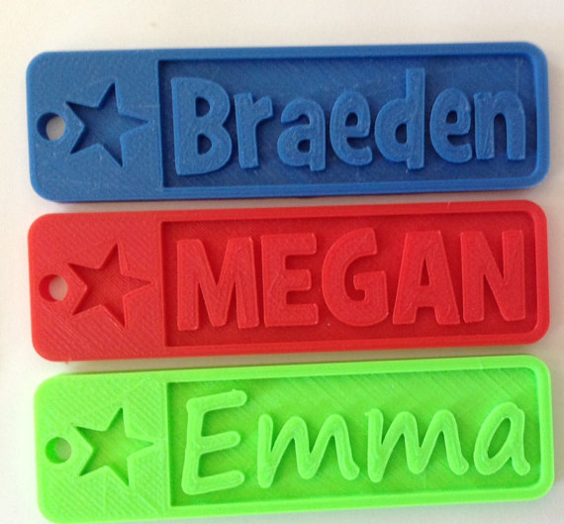
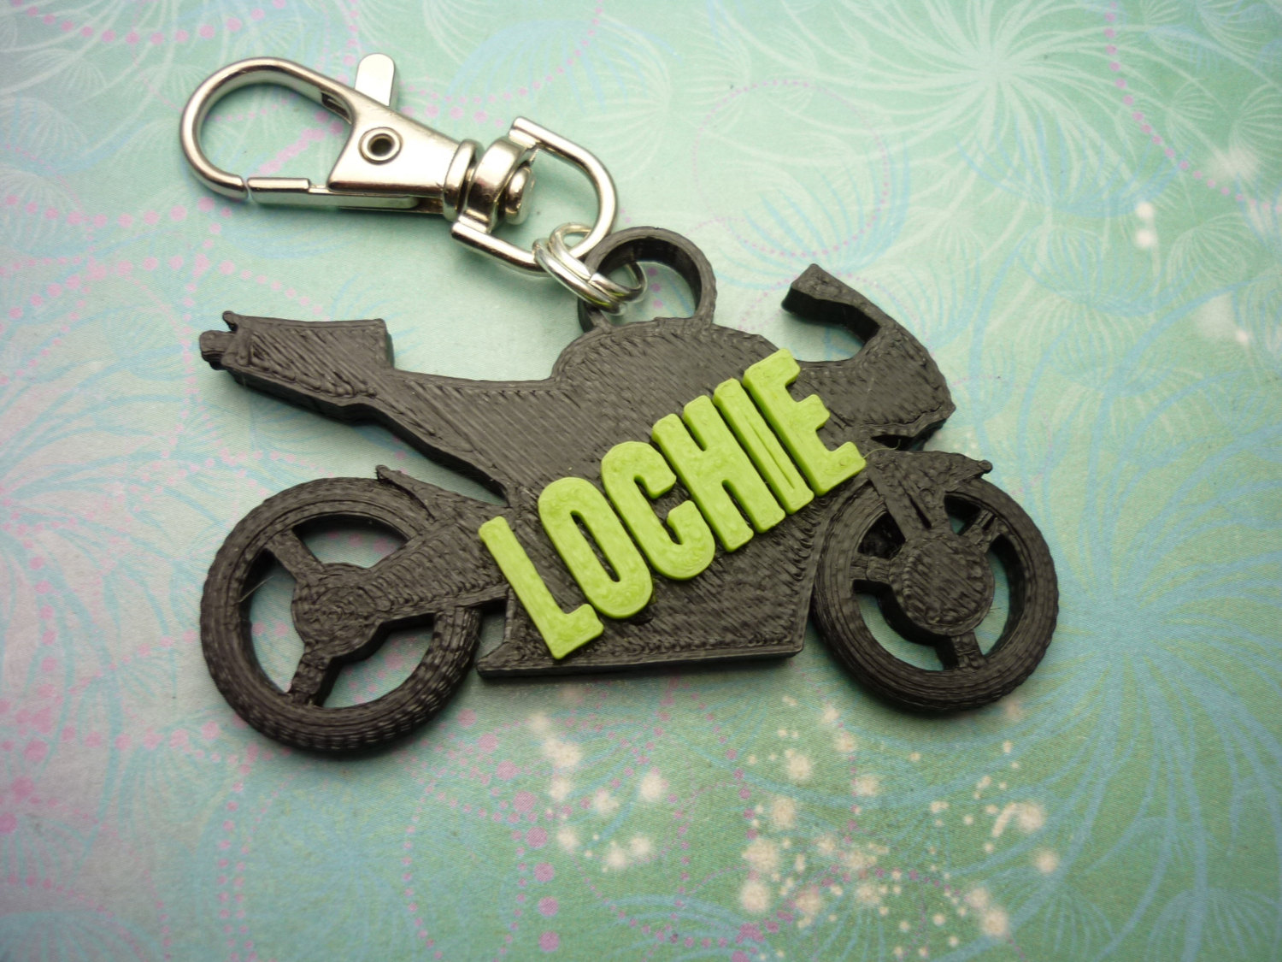
Let's make one of these!
Notes:
These can go on your bag, or onto some keys.

Slide 3
Step 1 - Plan what you’re going to make!
You’ll need to work out:
What shapes are you going to use to make your bag tag?
How big is your bag tag going to be? (How big will fit on the printer?)
How fine can the details be?
How will it attach to your bag?
How does it look from another angle?
You’re going to need some paper, pencils and a ruler!
Notes:
Before we can dig right in and get on the computers, we need to have a plan of what we’re going to do.

Slide 4
What shapes will you use to make your bag tag?
Here’s my design. It’s got a little castle top on it, a smiley face and my name.
But wait, it needs to be 3D too!
It’s hard to draw things in 3D on a piece of paper, but I’m going to write down that both my name and the smiley face will stick up from the surface.
Name sticks up
Notes:
** Might want to be signed in to tinker cad for this to show the shapes that’re available.

Slide 5
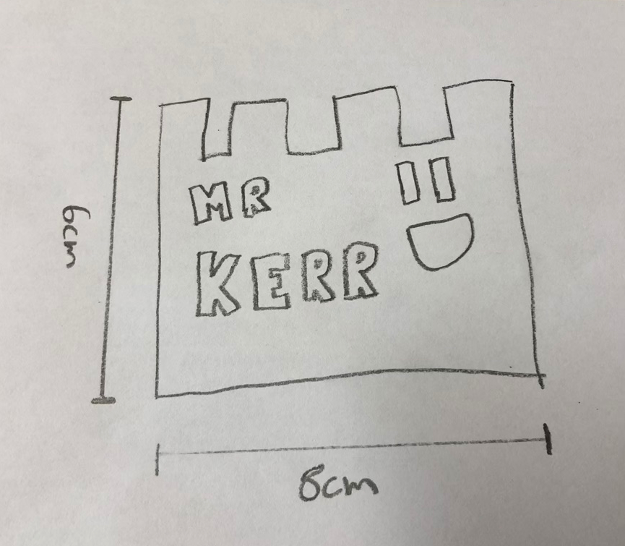
How big is your bag tag?
The 3D Printer can print objects up to 14cm x 14cm x 13cm. But this is pretty big for a bag tag!
Use a ruler and estimate what a good size is, then write it down on your design.
I’ve decided on 8cm x 6cm (that is 80mm x 60mm)
These are called Dimension Lines

Slide 6
How fine can the details be?
Aim for all your details on the bag being 2mm or larger.
If they’re too small, it’ll look like little dots, or even worse, it won’t appear at all!
This one came out a little too small!

Slide 7
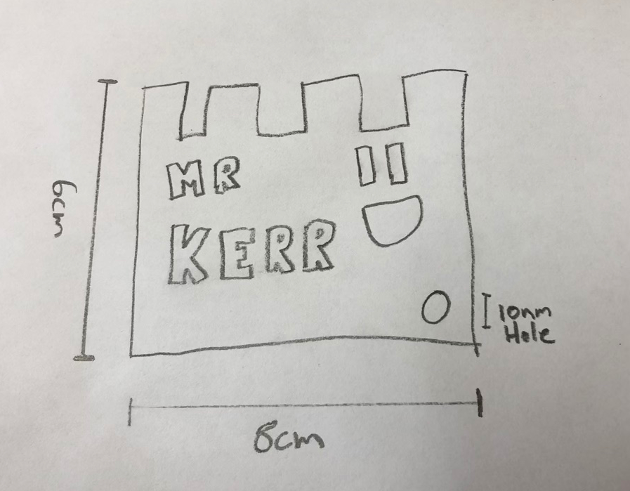
How will it attach to your bag?
The easiest way to attach it is with a bit of string, but how will the string attach to your bag tag?
I’ve decided on mine that I’m going to put a hole in the corner. I’ve also noted how big the hole should be. I’m going to say about 10mm is a nice size hole.
Here is the hole. It’s 10mm across.

Slide 8
How does it look from another angle?
Because we’re working with a 3D shape, you have to look at it from other angles too!
How does it look from the top? You don’t have to draw all the sides, but you need to know at least how thick your design will be.
These measurements tell me how thick my bag tag will be, and how much my name will stick out on the front.

Slide 9
My design is complete!
Get a teacher to check your design before you move onto the next step!
We can use this plan to build a 3D model of it in TinkerCAD next!

Slide 10
Part 2 - TinkerCAD
For this, you will need a device! You can do it on an iPad (with the App), a Chromebook or a laptop.
Go to the website: http://tinkercad.com
Click on Sign in with Google at the top of the screen
Once you’re logged in, click on Create New Design
The FIRST thing you do when you make a new design is give it a name, click up the top of the screen where it says a couple of random words (eg. Exquisite Esboo) and type in your name, class and design.
Eg. MrKerr-Stage3-Bag Tag
Notes:
Next part I guess should be done on the website demoing the features

Slide 11
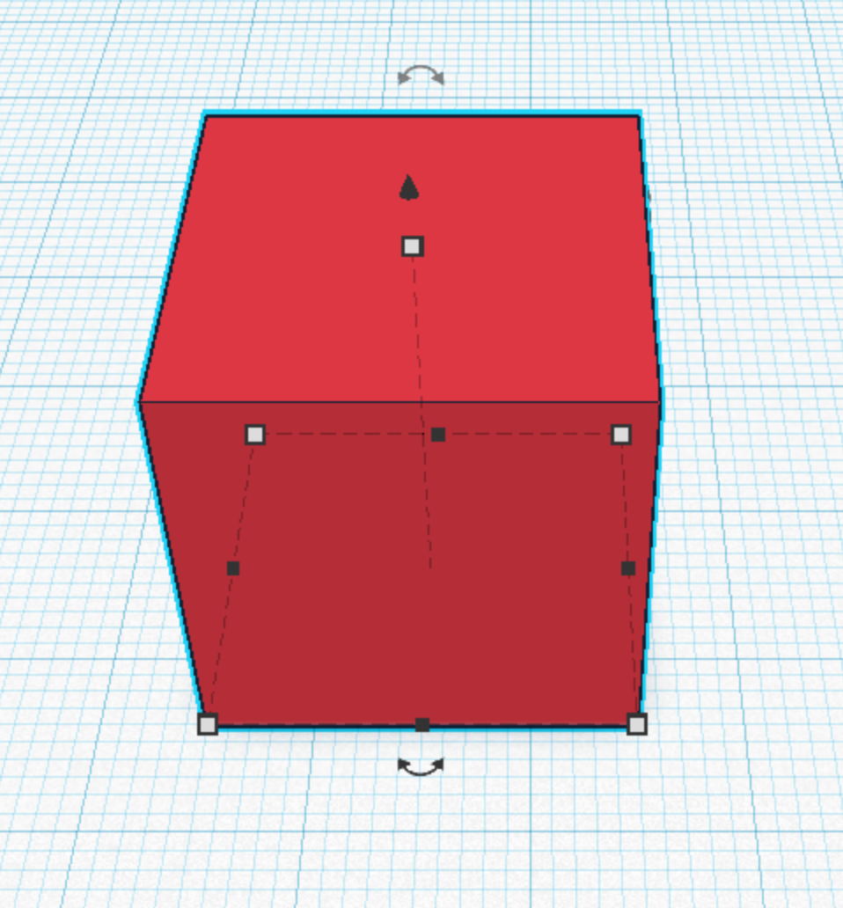
Cheat sheet
Move Object Up/Down (Arrow at top of object)
Resize Object (Black/White Squares on edges)
Rotate Object (Curved Arrows on edges)
Move Object Forward/Back/Left/Right (Click/Drag anywhere on the object)

Slide 12
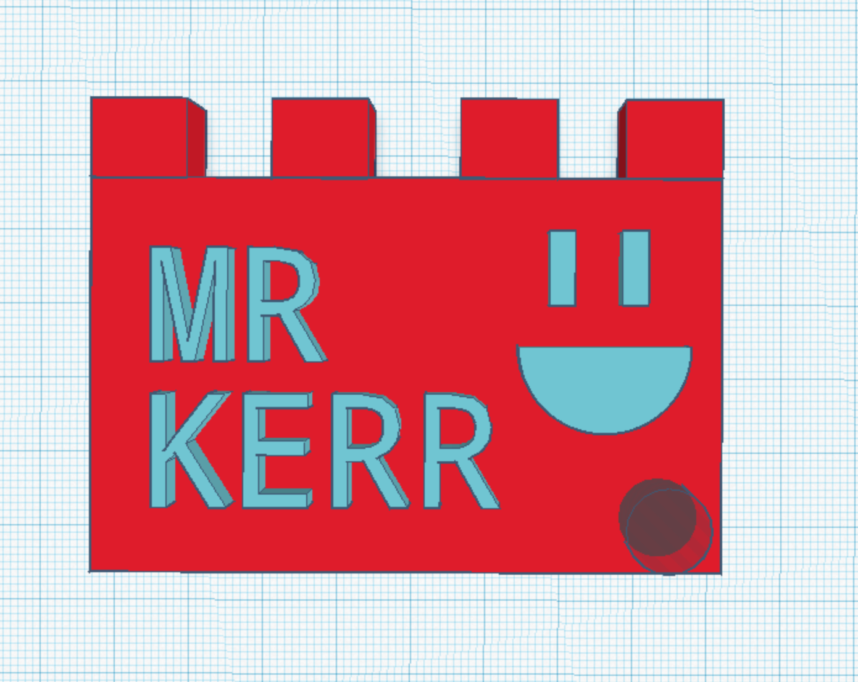
Check your design!
My design is complete!
Now I need to check it to make sure it will work!
Look at it from all different angles and make sure all the pieces are touching and that there’s no extra pieces that you don’t want to print.

Slide 13
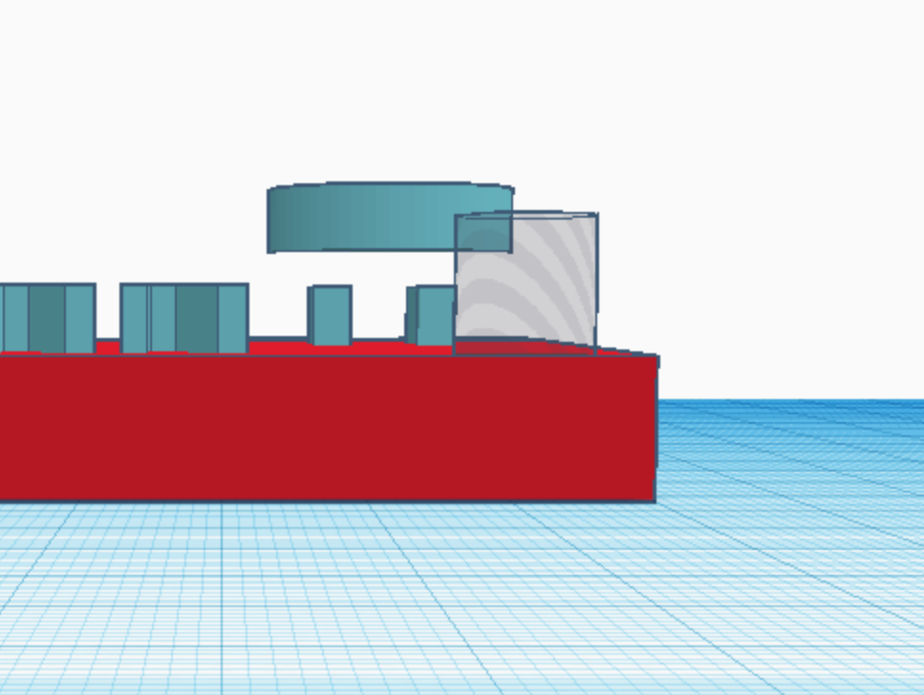
But… what’s this?!
It’s floating up in the air!
You need to make sure everything is touching!

Slide 14
What Next?
Once you’ve finished your model, you need to let a teacher know to add it to the list of things to print.
We will then download the file to send it to the printer.
Notes:
Teacher note: If you haven’t already set up TinkerCAD Classroom: Do it, it’s brilliant.

